Slide 1

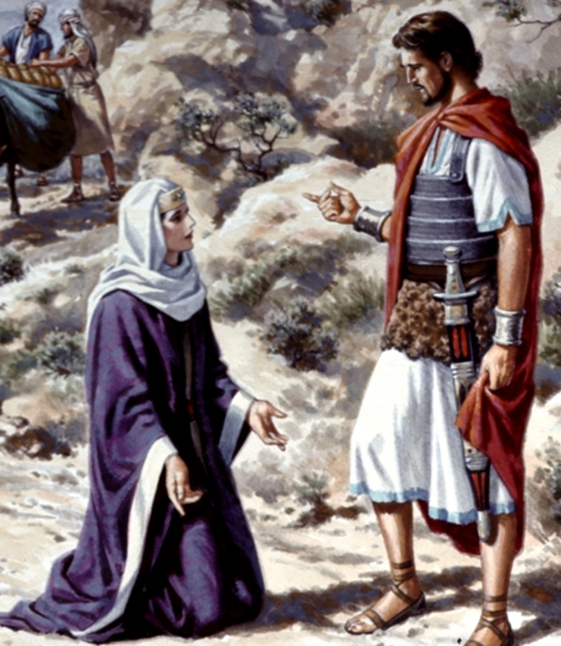
David’s Forgiveness
1 Samuel 25

Slide 2

NABAL vs ABIGAIL foolish wise
DIED PROMOTED

Slide 3
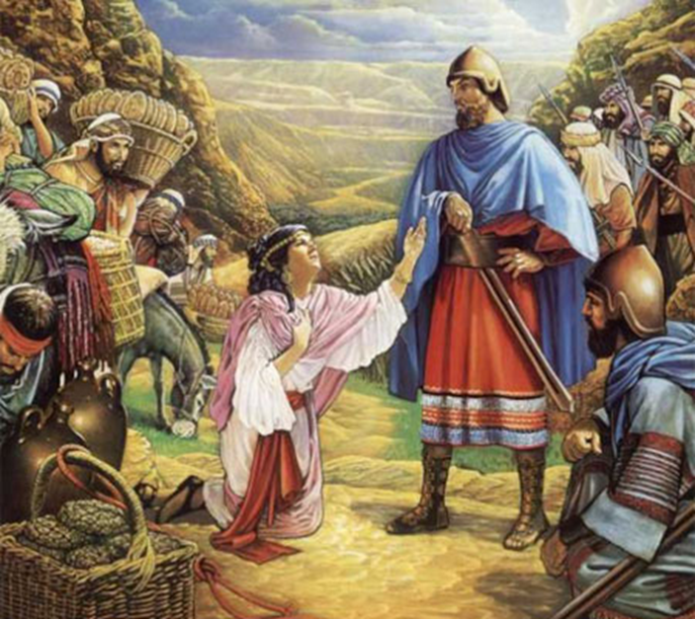
Abigail’s wise courage!
Vs 18: Bringing the peace offering.
Notice: she’s moving to prepare against a day of wrath that she KNOWS is coming.

Slide 4
David’s Forgiveness

Slide 5
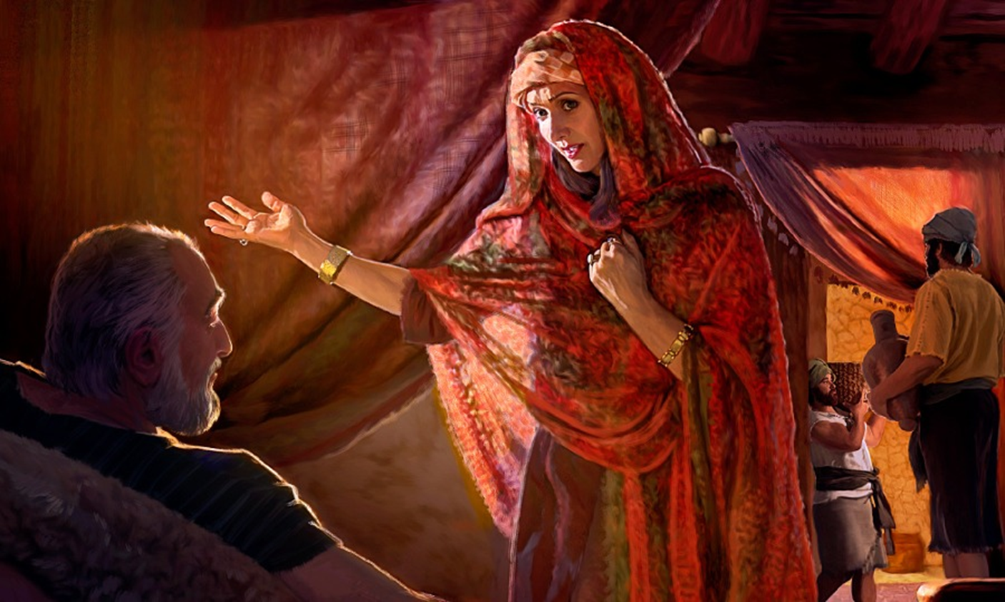
GOD’S FINAL JUDGMENT.

Slide 6
David’s response is dispensationally appropriate.
Today, biblically, we should hate every false way.
Let’s keeps our dispensations straight.

Slide 7
Ephesians 4:32 And be ye kind one to another, tenderhearted, forgiving one another, even as God for Christ's sake hath forgiven you.

Slide 8
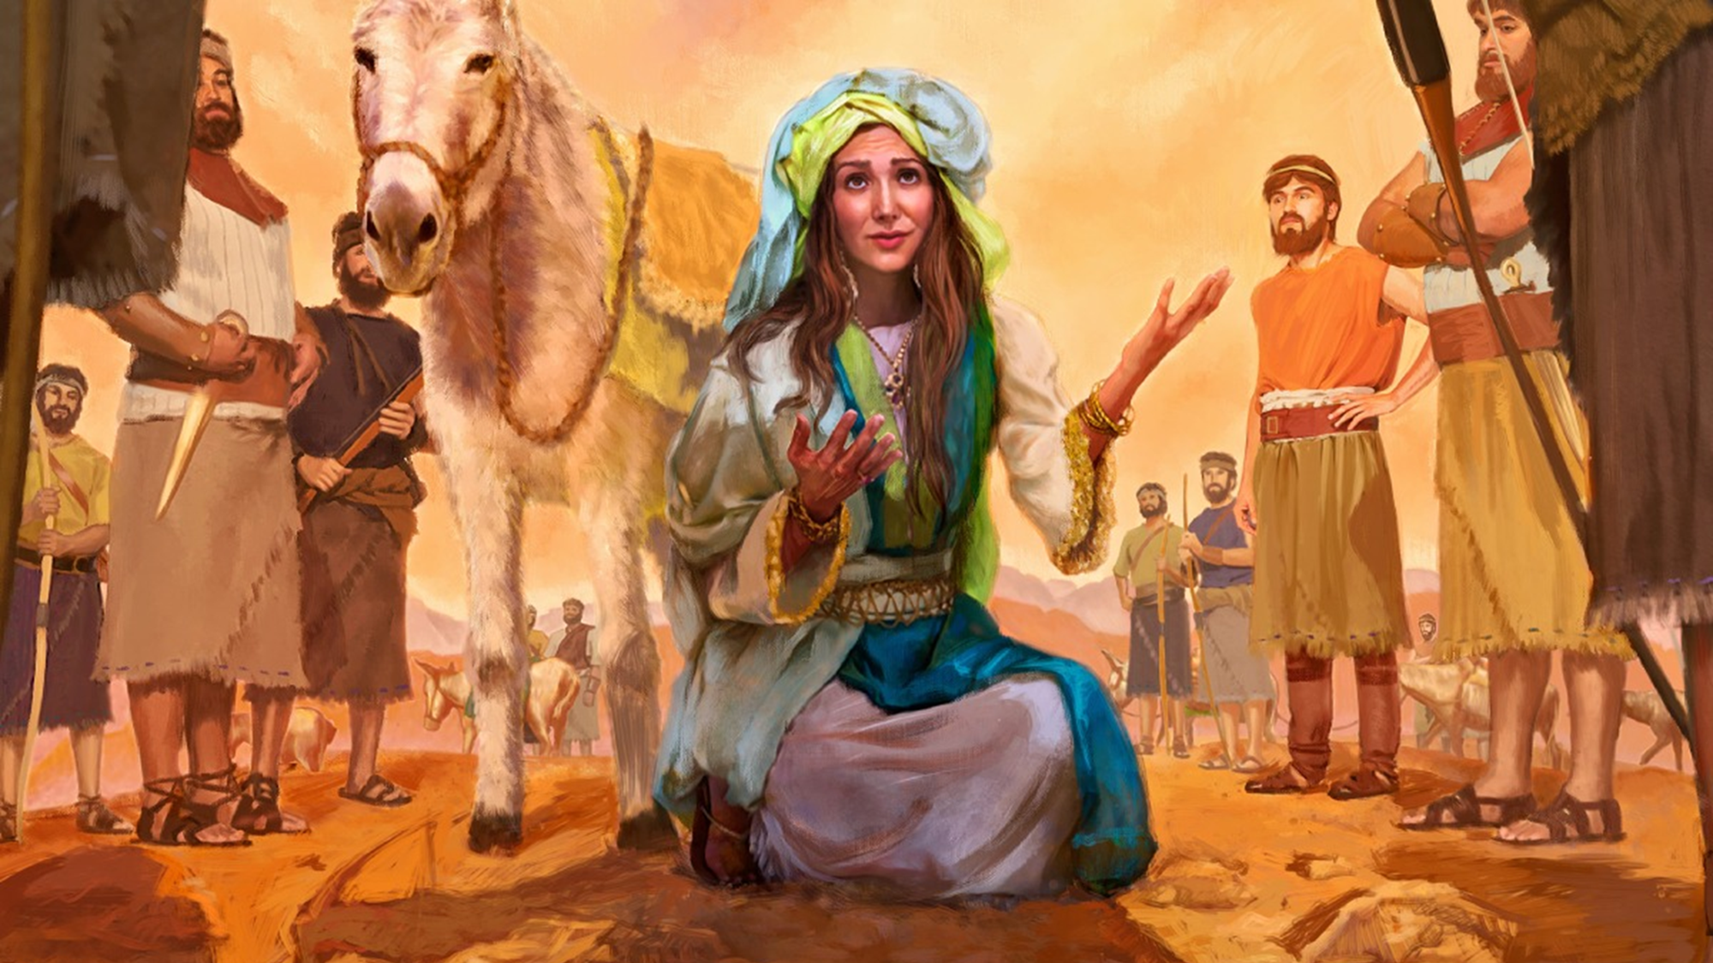
David’s marriage proposal. Vs 39-44

Slide 9

The marriage arrangements here are confusion.
1 Cor 14:33
Polygamy is contrary to God’s Word over the lives of His people!
God designed marriage to work with one man and one woman for life.

Slide 10
Genesis 2:24 Therefore shall a man leave his father and his mother, and shall cleave unto his wife: and they shall be one flesh.
1 Corinthians 7:1-2 Now concerning the things whereof ye wrote unto me: It is good for a man not to touch a woman. 2 Nevertheless, to avoid fornication, let every man have his own wife, and let every woman have her own husband.

Slide 11
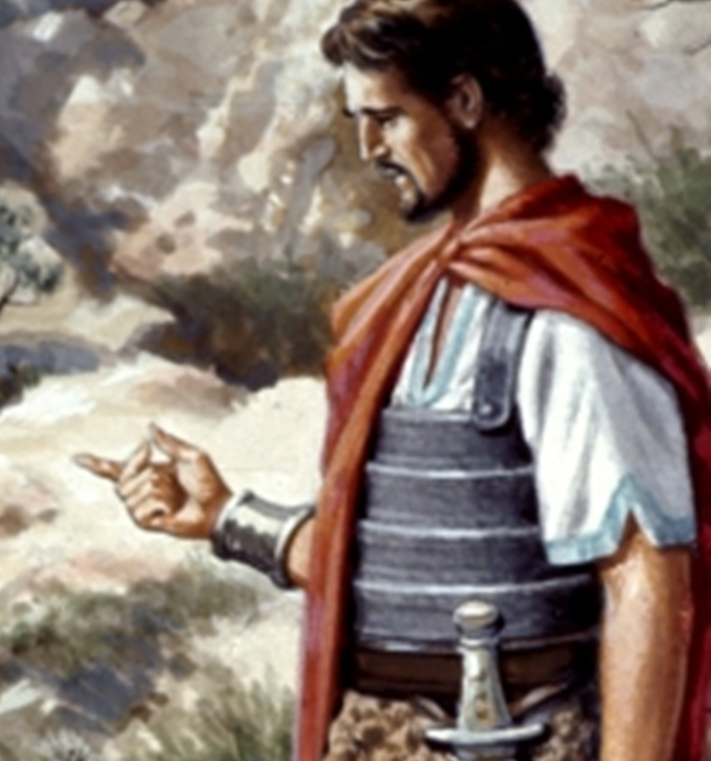
David was in direct violation of God’s Word to him!

Slide 12
Deuteronomy 17:14-19 When thou art come unto the land which the LORD thy God giveth thee, and shalt possess it, and shalt dwell therein, and shalt say, I will set a king over me, like as all the nations that are about me; 15 Thou shalt in any wise set him king over thee, whom the LORD thy God shall choose: one from among thy brethren shalt thou set king over thee: thou mayest not set a stranger over thee, which is not thy brother. 16 But he shall not multiply horses to himself, nor cause the people to return to Egypt, to the end that he should multiply horses: forasmuch as the LORD hath said unto you, Ye shall henceforth return no more that way.

Slide 13
Deuteronomy 17:17 Neither shall he multiply wives to himself, that his heart turn not away: neither shall he greatly multiply to himself silver and gold. 18 And it shall be, when he sitteth upon the throne of his kingdom, that he shall write him a copy of this law in a book out of that which is before the priests the Levites: 19 And it shall be with him, and he shall read therein all the days of his life: that he may learn to fear the LORD his God, to keep all the words of this law and these statutes, to do them:

Slide 14
Sin against God always defiles!

Slide 15
2 Samuel 11:4 And David sent messengers, and took her; and she came in unto him, and he lay with her; for she was purified from her uncleanness: and she returned unto her house.

Slide 16
Yet David defiled Bathsheba and himself with his adultery!

Slide 17
Multiple wives made for family chaos.

Slide 18
Hebrews 12:13-16 And make straight paths for your feet, lest that which is lame be turned out of the way; but let it rather be healed. 14 Follow peace with all men, and holiness, without which no man shall see the Lord: 15 Looking diligently lest any man fail of the grace of God; lest any root of bitterness springing up trouble you, and thereby many be defiled; 16 Lest there be any fornicator, or profane person, as Esau, who for one morsel of meat sold his birthright.

Slide 19
God doesn’t condone this marriage biblically. Yet, God allowed it to play out. Why?
So that you can get the picture of Christ and His bride!

Slide 20
Psalm 111:10 The fear of the LORD is the beginning of wisdom: a good understanding have all they that do his commandments: his praise endureth for ever.

Slide 21
Proverbs 31:10-12 Who can find a virtuous woman? for her price is far above rubies. 11 The heart of her husband doth safely trust in her, so that he shall have no need of spoil. 12 She will do him good and not evil all the days of her life.

Slide 22
Deuteronomy 6:4 Hear, O Israel: The LORD our God is one LORD:
  Jesus ALSO had a wife that he lost, Israel.
Isaiah 54:5 For thy Maker is thine husband; the LORD of hosts is his name; and thy Redeemer the Holy One of Israel;
  Israel is His wife. She was put away and then given to another!
Jeremiah 3:8 And I saw, when for all the causes whereby backsliding Israel committed adultery I had put her away, and given her a bill of divorce;
  But Israel will be restored! (Rom 11:26)
2 Samuel 3:14 And David sent messengers to Ishbosheth Saul's son, saying, Deliver me my wife Michal, which I espoused to me for an hundred foreskins of the Philistines.

Slide 23
Ephesians 5:30-32 For we are members of his body, of his flesh, and of his bones. 31 For this cause shall a man leave his father and mother, and shall be joined unto his wife, and they two shall be one flesh. 32 This is a great mystery: but I speak concerning Christ and the church.

Slide 24
Jesus took the church as bride after Israel was divorced and given to another.
Abigail pictures us!

Slide 25
Revelation 19:7-9 Let us be glad and rejoice, and give honour to him: for the marriage of the Lamb is come, and his wife hath made herself ready. 8 And to her was granted that she should be arrayed in fine linen, clean and white: for the fine linen is the righteousness of saints. 9 And he saith unto me, Write, Blessed are they which are called unto the marriage supper of the Lamb. And he saith unto me, These are the true sayings of God.

Slide 26
Romans 11:26 And so all Israel shall be saved: as it is written, There shall come out of Sion the Deliverer, and shall turn away ungodliness from Jacob:
2 Samuel 3:14 And David sent messengers to Ishbosheth Saul's son, saying, Deliver me my wife Michal, which I espoused to me for an hundred foreskins of the Philistines.

Slide 27
How do you become part of the bride of Christ?
Vs 40 – you must respond to the invitation!
Once you accept the invitation to be Christ’s, you must follow after Him!

Slide 28
David’s Forgiveness
1 Samuel 25

